Slide 1
Highlights from our annual report 2019/20
Dr Carol Homden CBE
Chair, Board of Trustees

Slide 2
Our annual report
Introduction
Welcome to our first online AGM
Here are some key highlights from our annual report, demonstrating how UK-wide the National Autistic Society has:
Transformed lives through direct services and branches
Changed attitudes through campaigns and information

Slide 3
Transforming lives

Slide 4
Transforming lives

Slide 5
Transforming lives in Scotland

Slide 6
Transforming lives in Northern Ireland

Slide 7
Transforming lives in England

Slide 8
Transforming lives in Wales
Sustaining adult residential, supported living and day services in Wales and across the UK

Slide 9
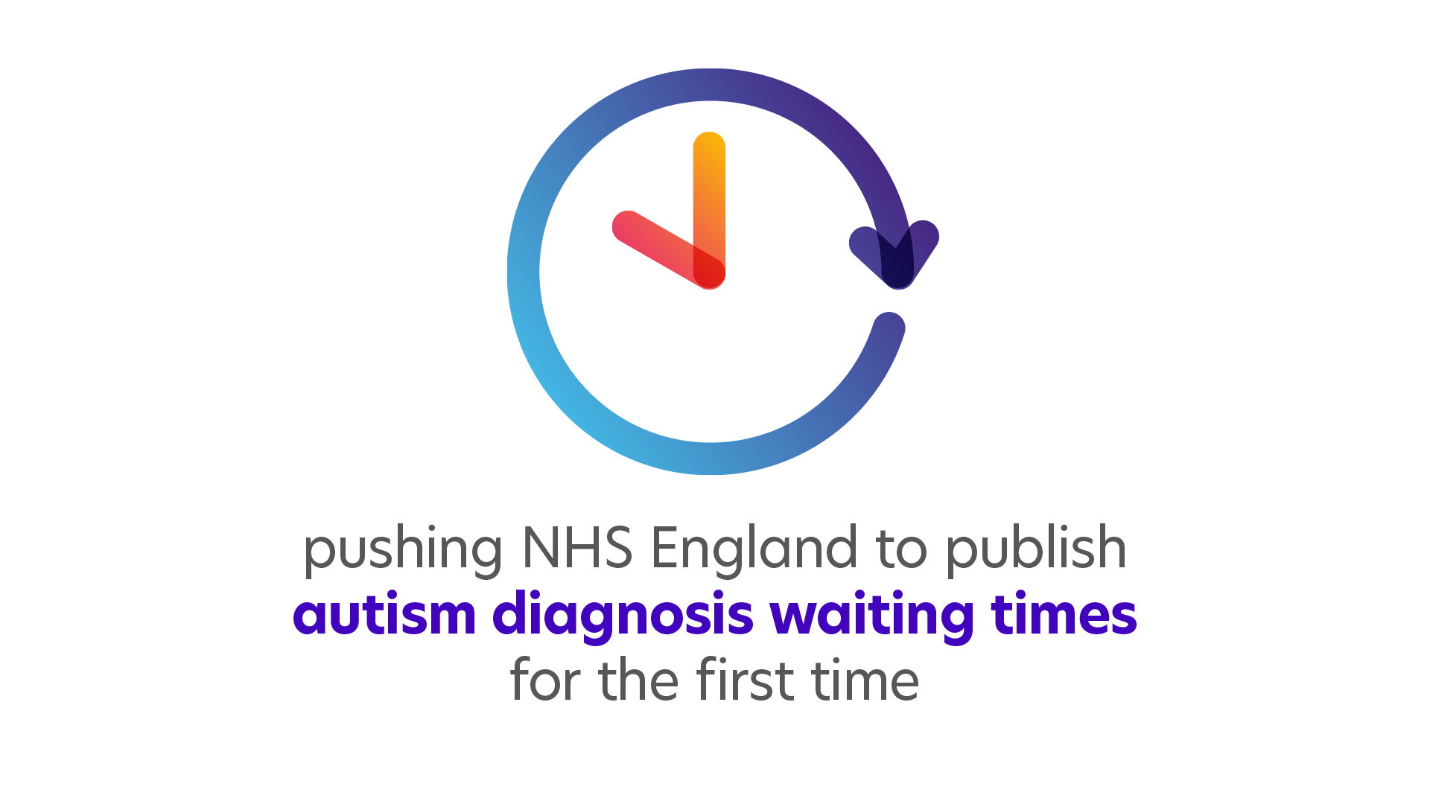
Changing attitudes

Slide 10
Changing attitudes

Slide 11
Changing attitudes

Slide 12
Changing attitudes

Slide 13
Changing attitudes

Slide 14
10 year view
10 years since the Autism Act
First autism specific Free schools
Too Much Information Campaign
Every day support for every day life
And now a new chapter as we approach our 60th birthday
Time to hand on to a new Chair, and to hand over to our CEO

Slide 15
Thank you!

